Slide 1
Multi-sensor accelerometer-based gesture recognition
Bc. Matej Králik
Supervisor: Mgr. Vladimír Boža PhD.
Consultant: Mgr. Marek Šuppa
Notes:
Povedat ze nasa praca sa zaobera x a y

Slide 2
Research area
Human Activity Recognition (HAR)
  Hand Gesture Recognition (HGR)
Inertial sensors
Applications in:
VR, AR, health, entertainment, smart homes
Notes:
AR je co akoze po slovensky? Augmented realita?

Slide 3
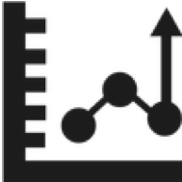

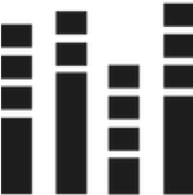



Goals of our work
Exploration of multi-sensor HGR
    Custom prototype
    Design and creation of a dataset
Classification in HAR & HGR
  Compare multiple datasets
  Classical Machine Learning & Deep Learning
Notes:
Ze bude aj ablacna studia ! A co to je

Slide 4
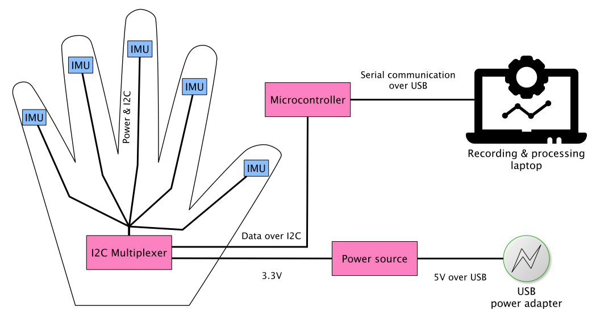
WAVEGLOVE prototype

Slide 5
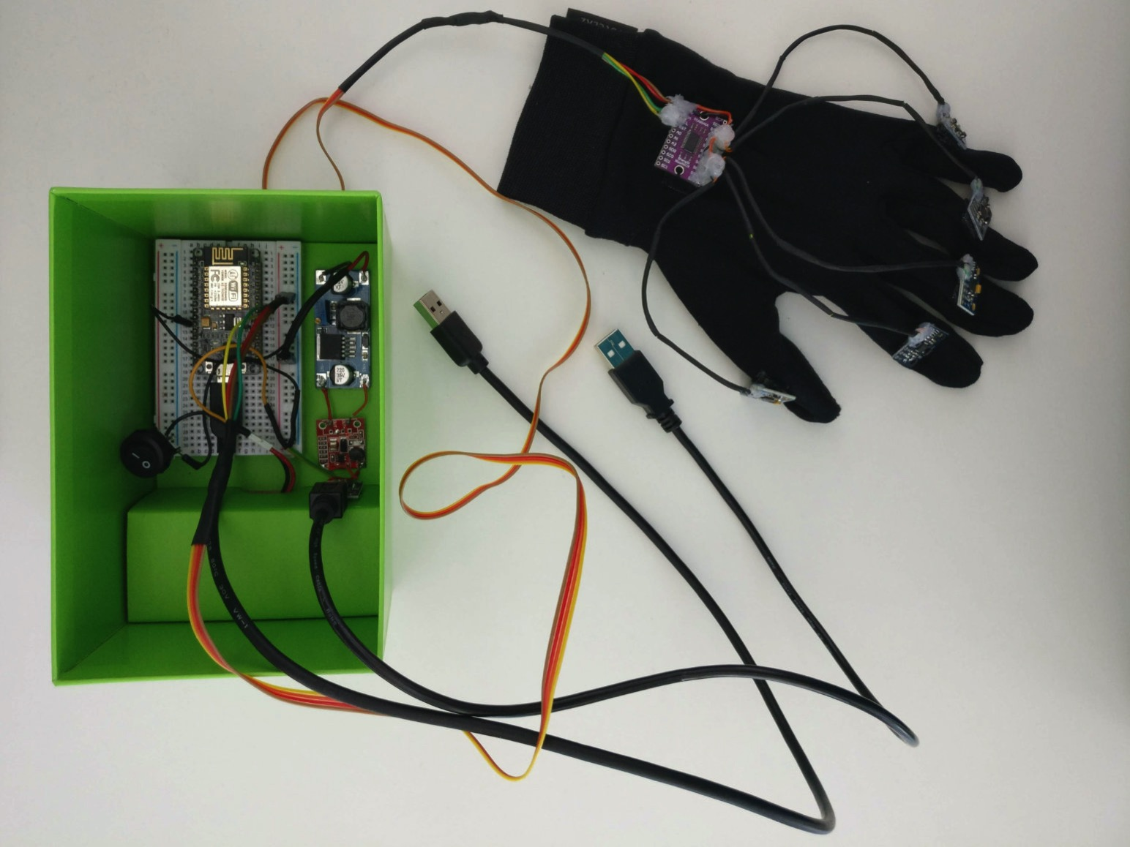
WAVEGLOVE prototype

Slide 6
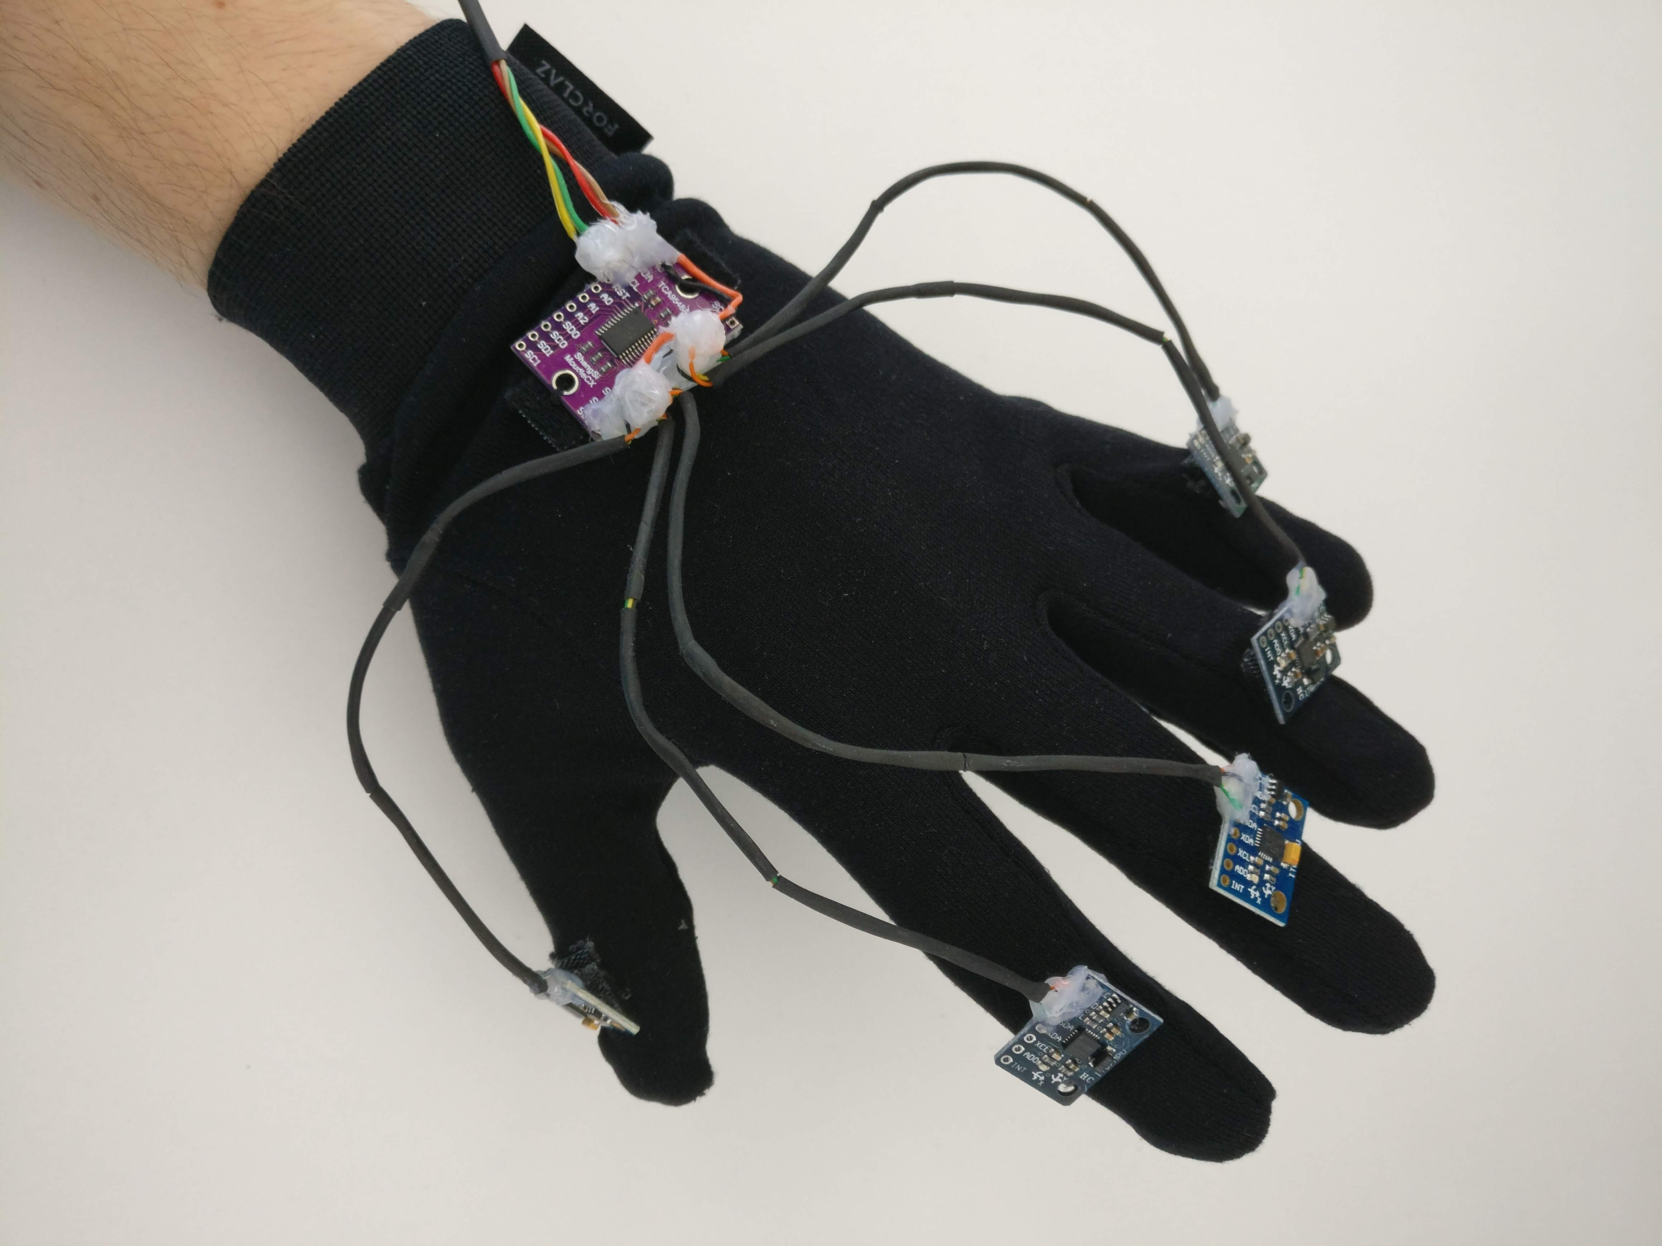
WAVEGLOVE prototype

Slide 7
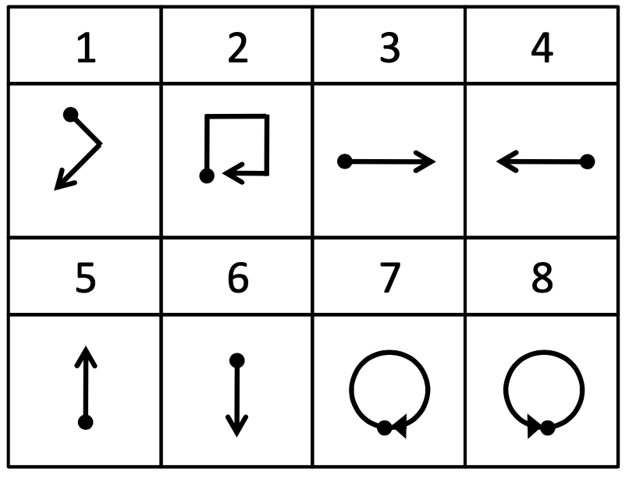
Vocabulary
WAVEGLOVE-single
Vocabulary adapted from
[1] J. Liu et al. uWave: Accelerometer-based personalized
gesture recognition and its applications.
Pervasive and Mobile Computing, 5(6):657–675, 2009.

Slide 8
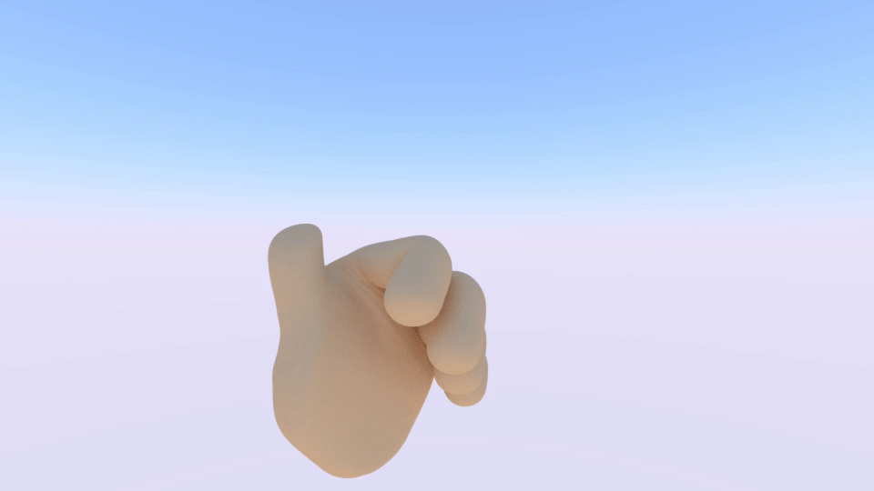
Vocabulary
WAVEGLOVE-multi
Thumb double tap

Slide 9
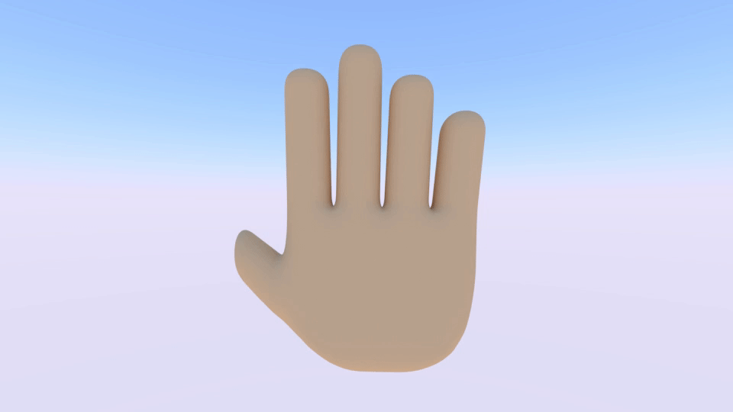
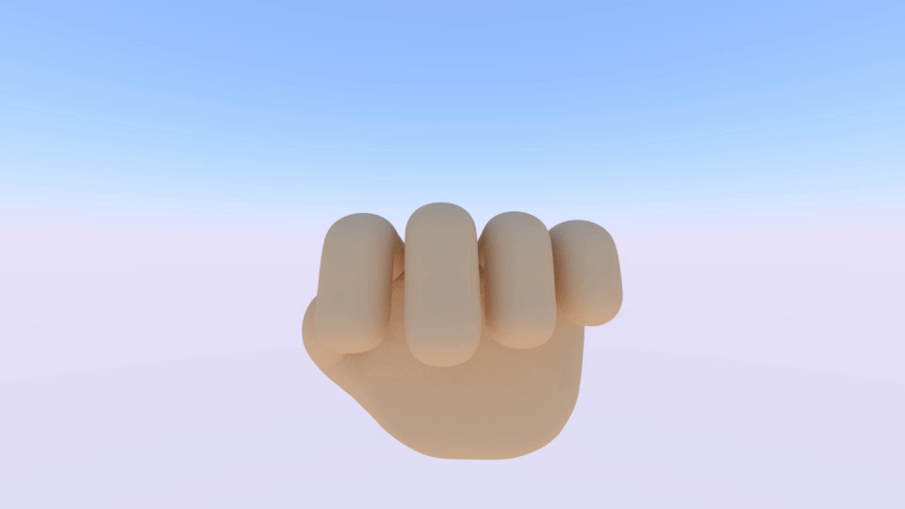
Vocabulary
WAVEGLOVE-multi
Grab
Ungrab

Slide 10
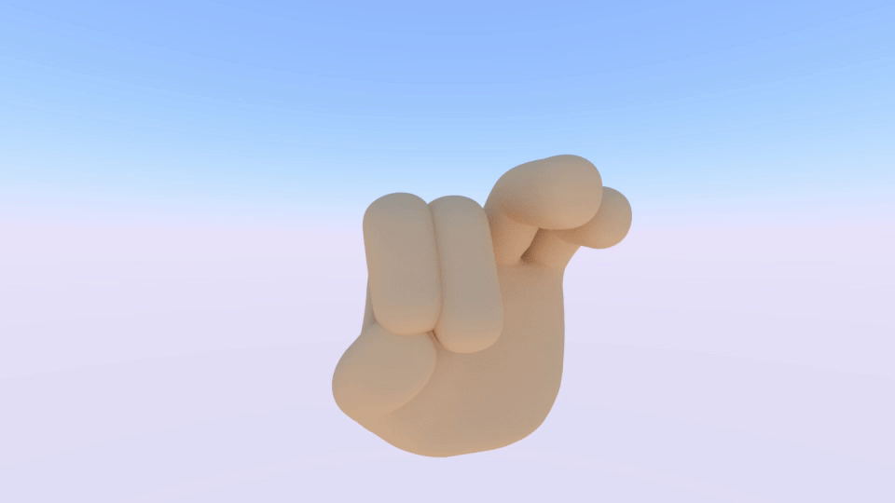
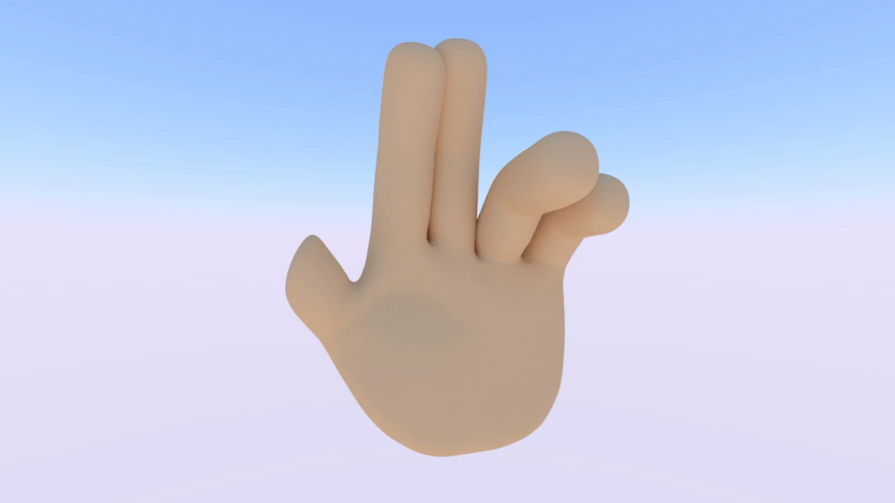
Vocabulary
WAVEGLOVE-multi
Pinch closer
Pinch away

Slide 11
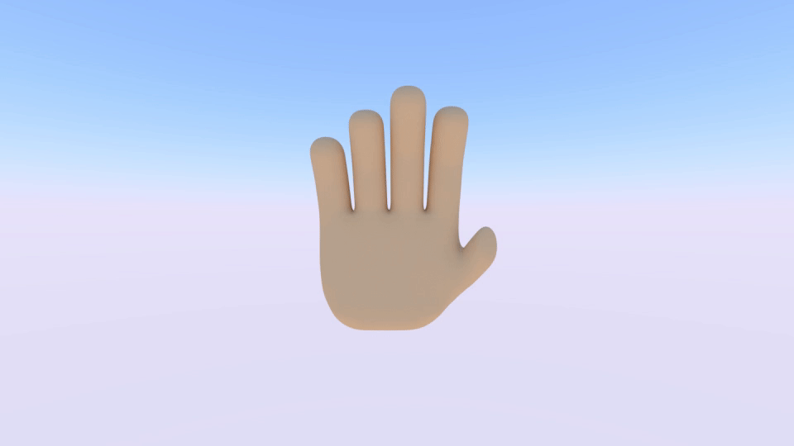

Vocabulary
WAVEGLOVE-multi
Peace
Metal

Slide 12
Dataset acquisition
Short sessions
  Gesture from each class performed three times
  Two second break between classes
  Shuffled class order
Notes:
Mame vlastnu appku kde toto robime, fajne !

Slide 13
Properties of the datasets
Notes:
Ze nevieme o inom publicly available hgr datasete s takym mnozstvom a viacerymi senzormi
Dokopy viac ako 16 hodin mavania
Dajme boha prec tolko grafov, vobec neni jasne naco sa pozerat

Slide 14
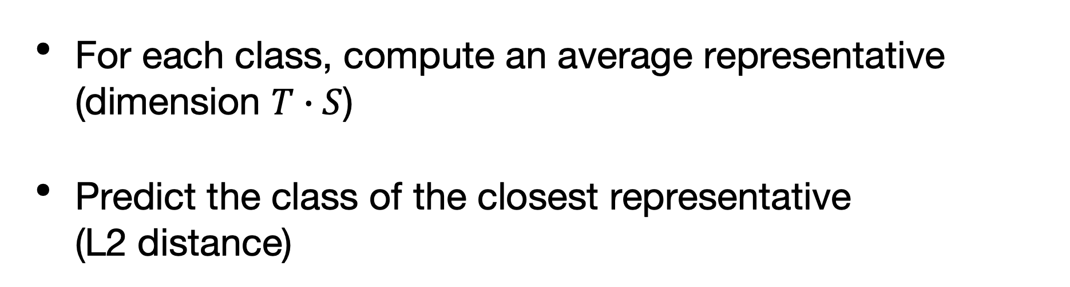
Baseline classification
For each class, compute an average representative
(dimension $T∙S$)
Predict the class of the closest representative
(L2 distance)

Slide 15
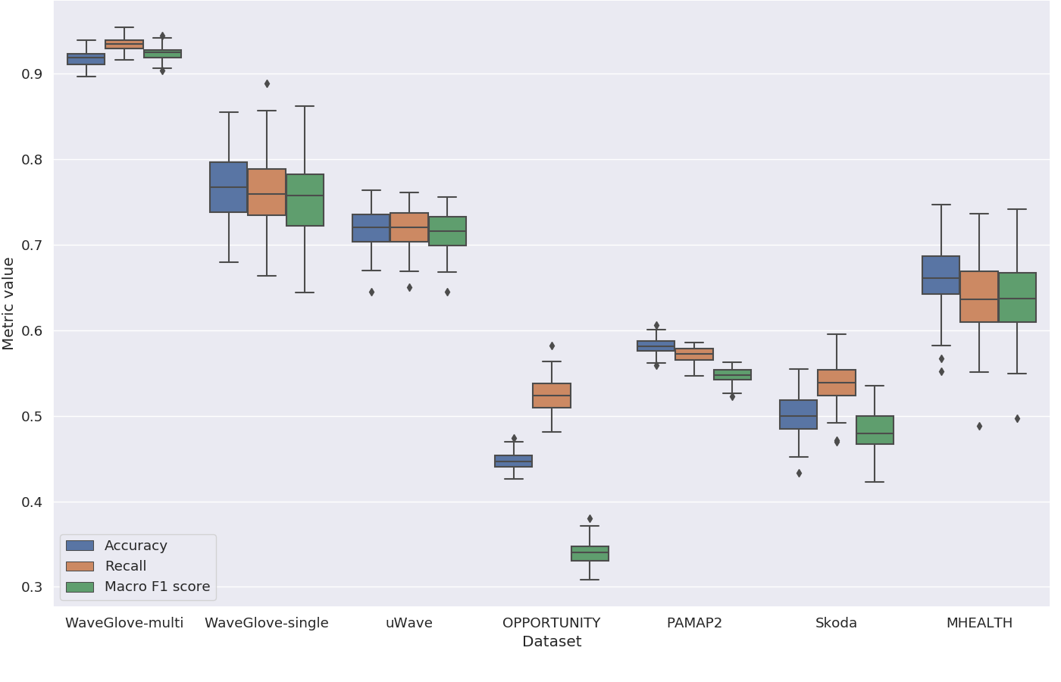
Baseline classification

Slide 16
Recurrent neural networks
Attention
Notes:
Ze su RNN, co je zhruba LSTM, ze tam je nelinearita..
Ako vystup sa zoberie vystup poslednej bunky
U nas sa ukazalalo ze davaju sekvencie priblizne do dlzky 60
Vylepsuje sa to pomocou attention.. Natrenovana matica alebo ine techniky ako priradit vahy h-ckam, miesto toho zobrat len posledne

Slide 17
Recurrent neural networks:
Implemented models
LSTM w. time-embedding
LSTM w. attention

Slide 18
Self-attention, Transformer networks
The Transformer, proposed in [2]
shows superior performance in NMT
Proposed novel
Transformer-based architecture
Replaces recurrent layers
with attention mechanism
We propose a similar architecture for HAR
using self-attention and
sensor-embedding
[2] A. Vaswani, et al. Attention is all you need. Advances in NIPS 30: Annual Conference on NIPS 2017, p. 5998–6008.

Slide 19
Performance comparison
with random train-test split
DeepConvLSTM from
[3] F. J. Ordóñez and D. Roggen. Deep convolutional and LSTM recurrent neural networks for multimodal wearable activity recognition. Sensors,16(1):115, 2016.
Notes:
Toto je tiez nanic
Ser na to, daj tam len “najlepsie vysledky“.. Dclstm..

Slide 20
Performance comparison
with LOTO cross-validation
Method | MHEALTH | USC-HAD | UTD-MHAD1 | UTD-MHAD2 | WHARF | WISDM
Best reported in previous work | 94.72 | 88.49 | 67.29 | 86.50 | 75.50 | 91.23
Bagging Decision tree | 93.41 | 89.22 | 67.51 | 81.90 | 66.26 | 61.61
CNN | 87.35 | 89.87 | 62.74 | 83.47 | 78.03 | 90.59
LSTM | 81.69 | 82.96 | 63.61 | 72.00 | 67.76 | 79.34
LSTM w. attention | 86.44 | 89.79 | 69.72 | 84.13 | 81.47 | 90.07
Self-attention w. sensor-emb. | 90.35 | 89.83 | 76.32 | 88.42 | 78.63 | 84.53
Datasets and splits, as in:
[4] A. Jordao, et al. Human activity recognition based on wearable sensor data: A standardization of the state-of-the-art. CoRR, 2018.
Notes:
Co je to vobec to LOTO?

Slide 21
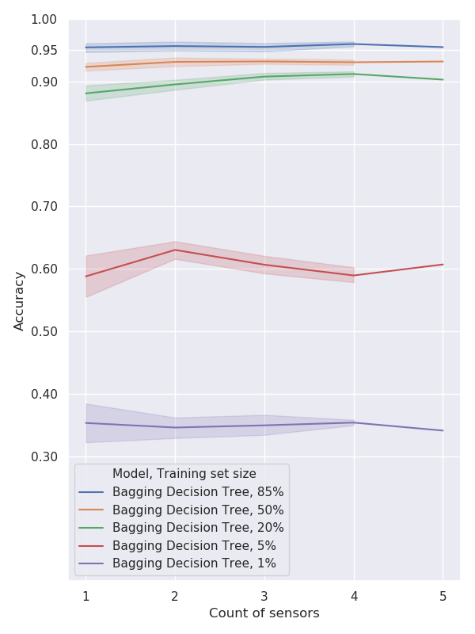
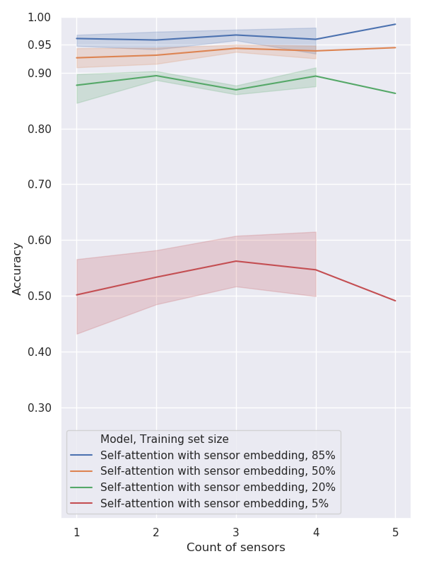
Ablation study: WAVEGLOVE-single
Notes:
Bagging decision tree zrazu? Mozno daj len sensor embedding

Slide 22
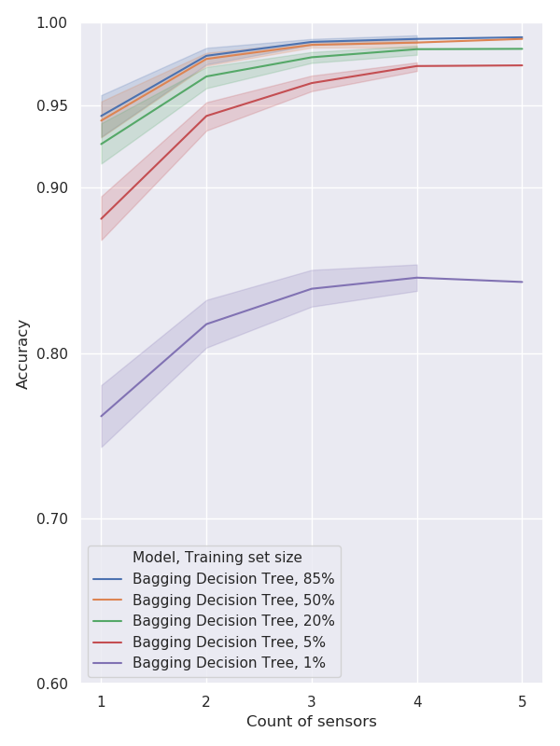
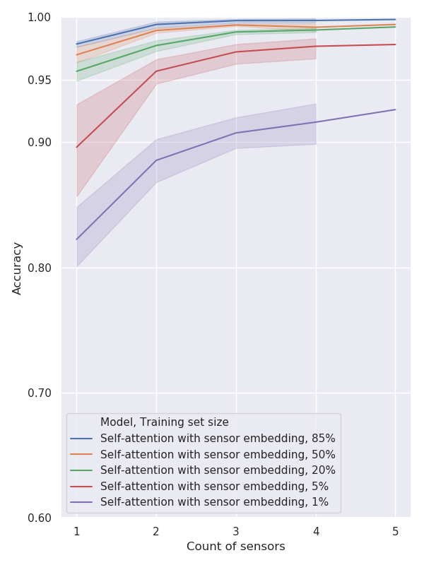
Ablation study: WAVEGLOVE -multi

Slide 23
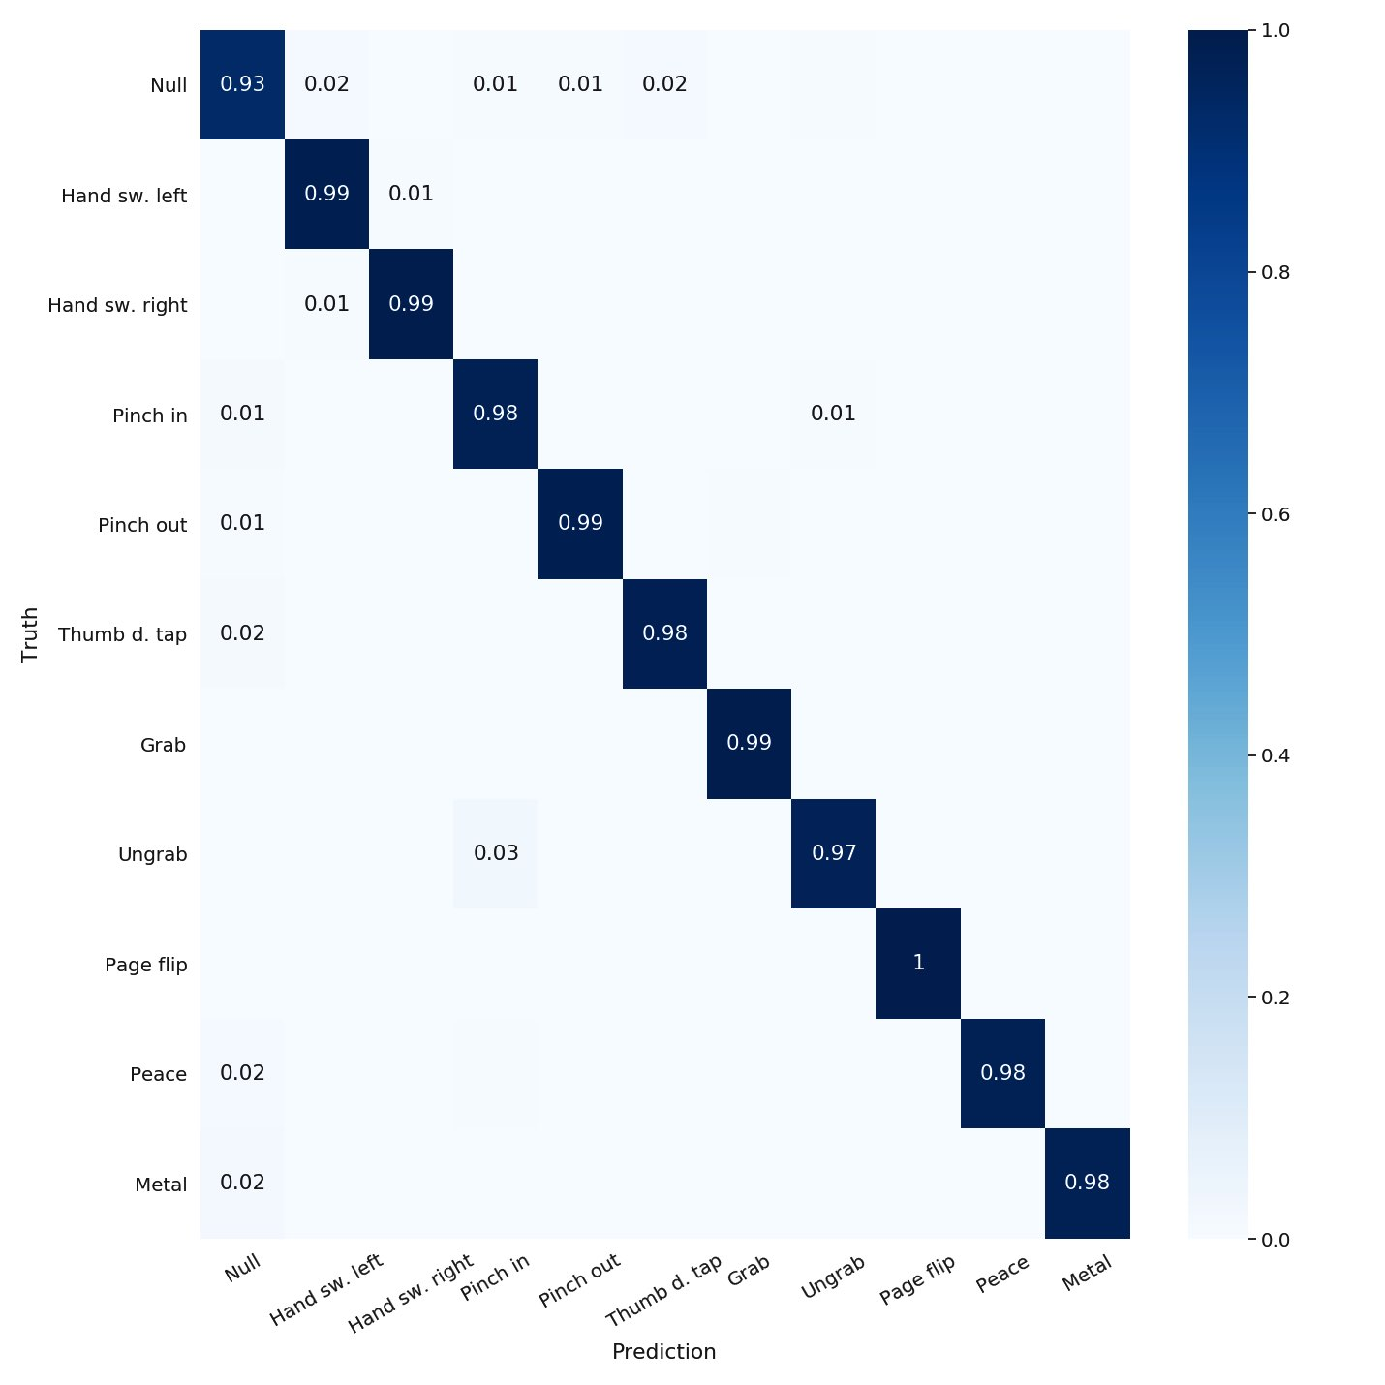
Ablation study: Finger attribution
Using data from all 5 fingers leads to near-perfect accuracy.
Notes:
Toto asi tiez prec len povedz ze 100%

Slide 24
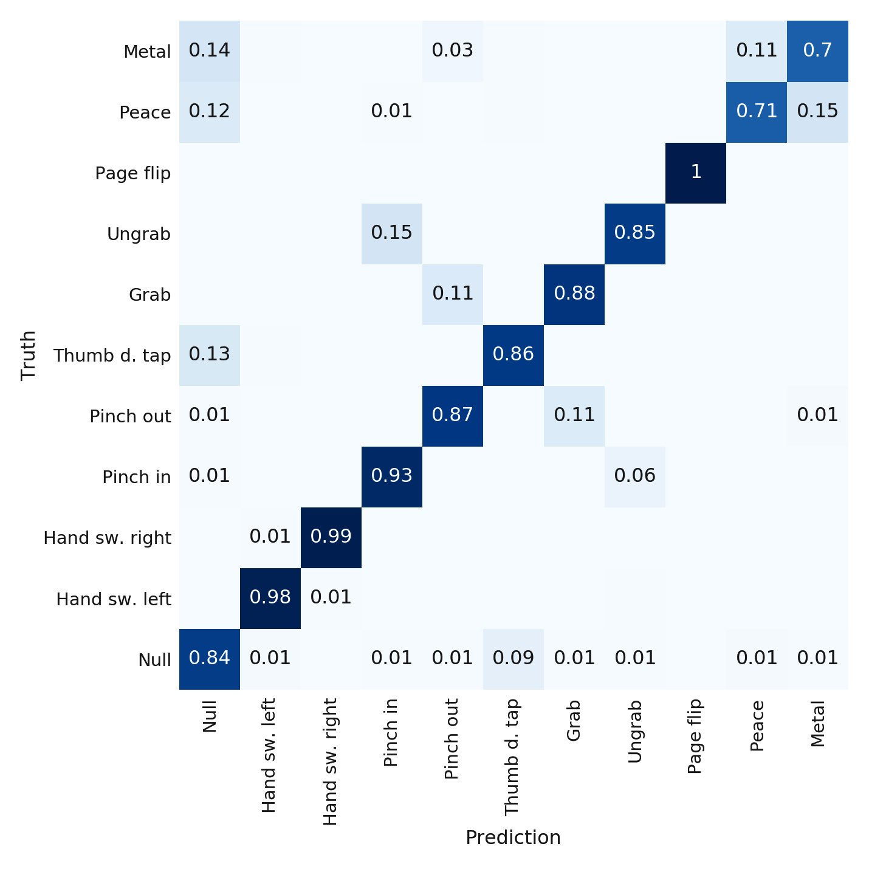
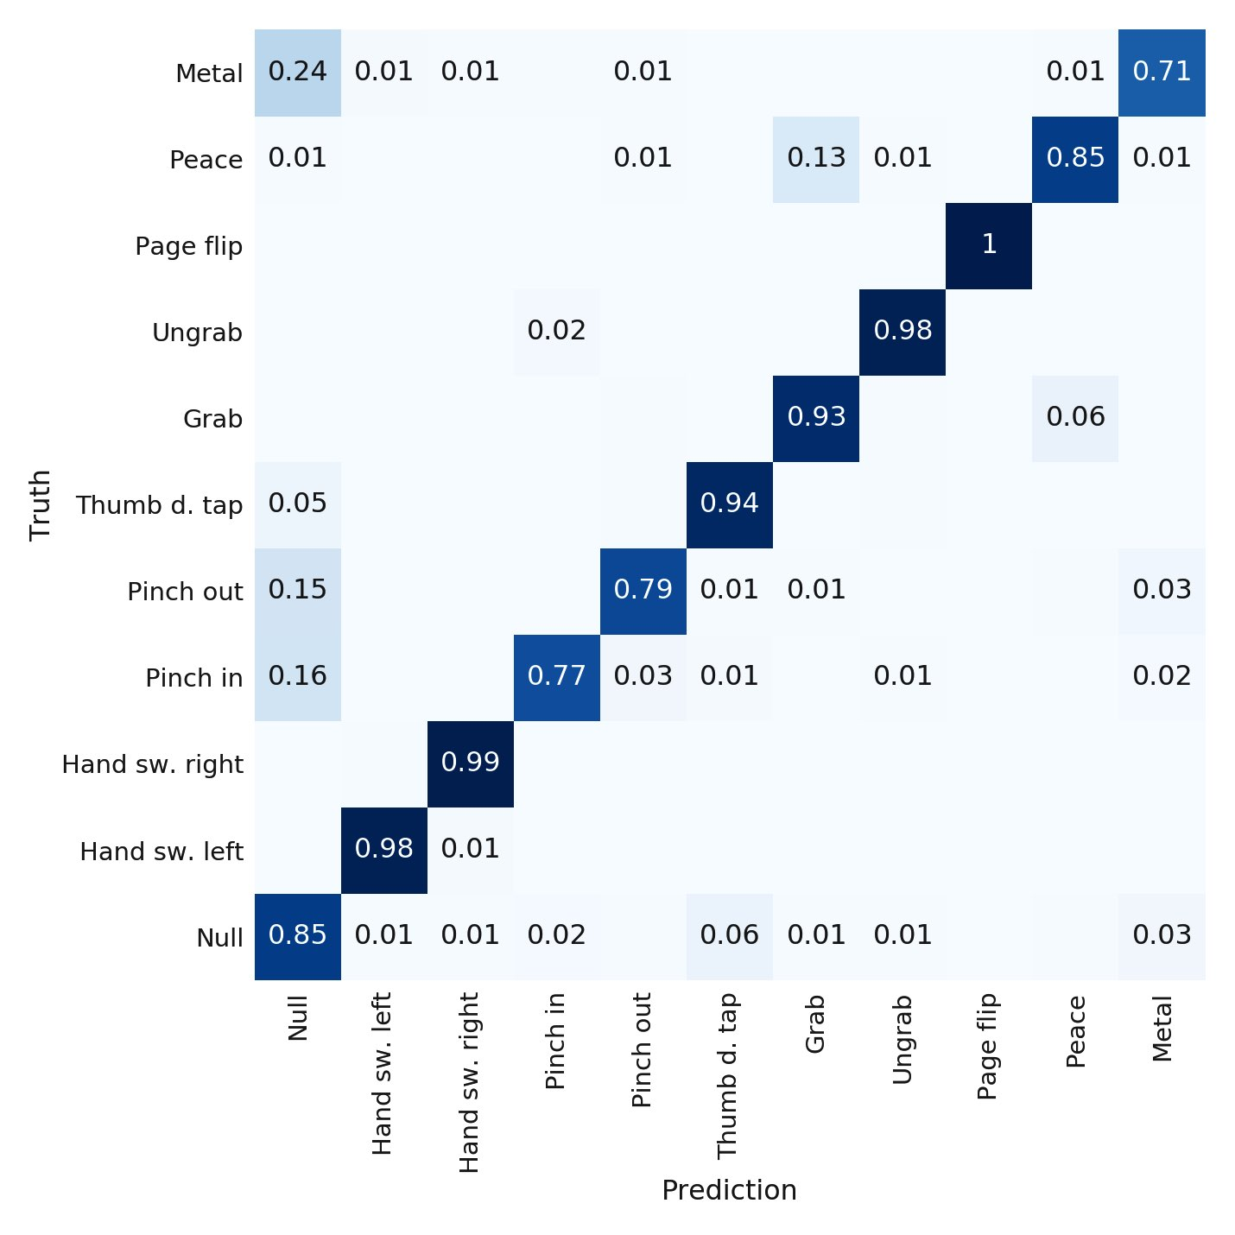
Ablation study: Finger attribution
Index finger
Pinky

Slide 25
Conclusions
Attention and self-attention
improve performance slightly
Sample generation & train-test splits
fundamentally affect the results
Up to three sensors
increase accuracy significantly
Gesture difficulty varies
based on the sensors used
Notes:
!! Sample generation doteraz nespomenute

Slide 26


Contributions
Future work
Prototype construction
Two datasets,
over 11000 samples
Comparison of several methods & datasets
Proposed a novel
self-attention based model
Ablation study
Investigate the effect of sample generation and train-test splits
Further application of
self-attention
Continuous recognition
Notes:
Mozno postupne zobrazovanie, contributions a future work!!

Slide 27
Novelty of the proposed model and differences from previous work
Proposed
Transformer-based architecture

Slide 28
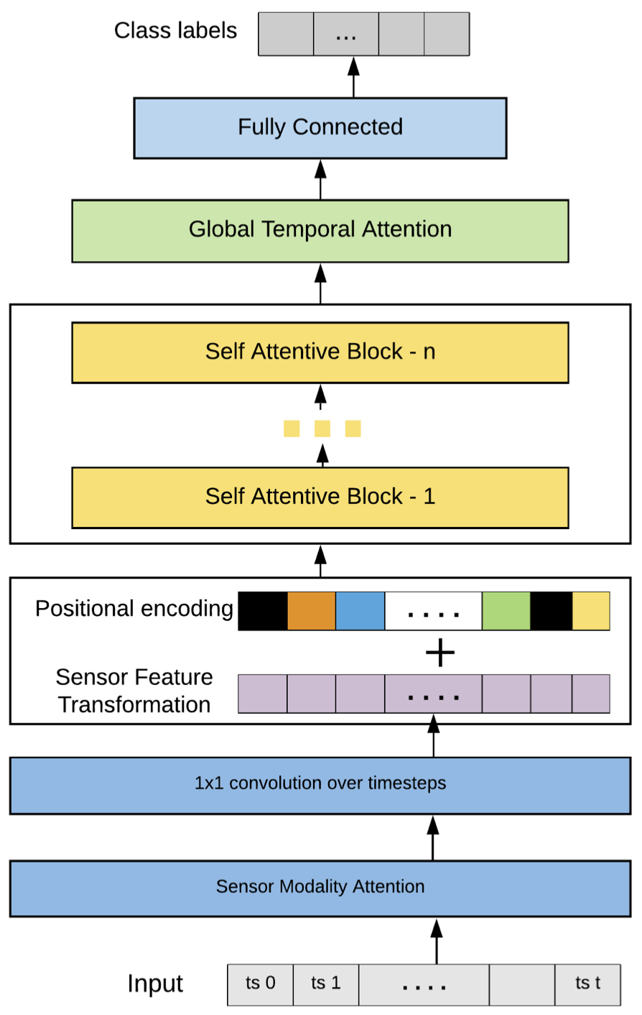
Model & figure from
[5] S. Mahmud, et al. Human activity recognition from wearable sensor data using self-attention. CoRR, 03/2020.
Proposed
Transformer-based architecture

Slide 29
Published all hyperparameters and code.
Architecture & figure from
[5] S. Mahmud, et al. Human activity recognition from wearable sensor data using self-attention. CoRR, 03/2020.
Proposed
Transformer-based architecture

Slide 30
Transfer learning opportunity
uWave and WAVEGLOVE-single
use the same vocabulary
Different number of sensors → pooling
→ learned weights
[1] J. Liu et al. uWave: Accelerometer-based personalized
gesture recognition and its applications.
Pervasive and Mobile Computing, 5(6):657–675, 2009.

Slide 31
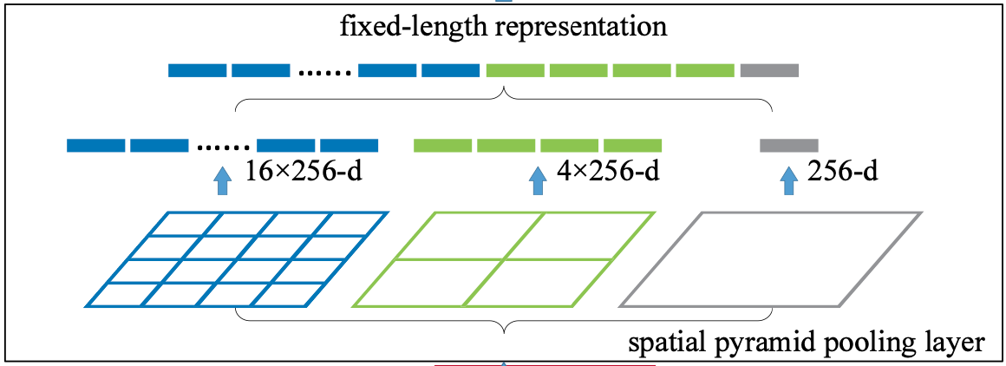

Variable sensor modality
Padding
RNN in sensor dimension
(if temporal dimension is constant)
Cuttting & Stretching
Spatial Pyramid Pooling [6]
[6] K. He, et al. Spatial Pyramid Pooling in Deep Convolutional Networks for Visual Recognition. CoRR, 2014.
← Time →
Sensor
RNN
RNN
Zeros

Slide 32
Contributions
Future work
Prototype construction
Two datasets,
over 11000 samples
Comparison of several methods & datasets
Proposed a novel
self-attention based model
Ablation study
Investigate the effect of sample generation and train-test splits
Further application of
self-attention
Continuous recognition
Notes:
Mozno postupne zobrazovanie, contributions a future work!!

