Slide 1
Analysis of virtual machine based obfuscators
Vladislav Hrčka RNDr. Jaroslav Janáček, PhD Mgr. Peter Košinár
Notes:
Na uvod zacnem uvedenim niekolkych zakladnych pojmov. Obfuskacia kodu je proces, ktorym robime kod tazsie citatelny. Pracu som robil popri praci v ESETe a bola publikovana na ich blogu a prezentoval na niekolkych konferenciach v zahranici

Slide 2
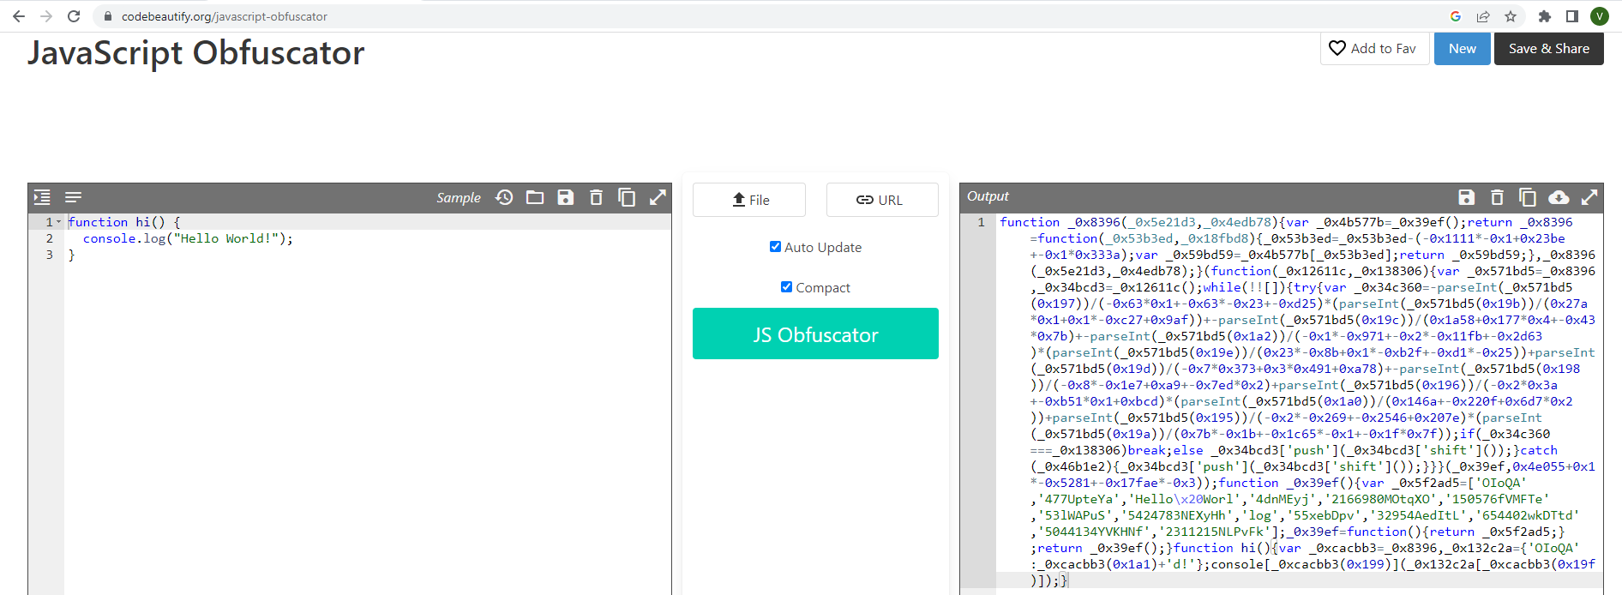
Introduction – obfuscation
Obfuscated javascript:
Notes:
Primarnym poslanim obfuskacie je chranit dusevne prava vlastnika – napriklad v hernom priemysle sa aj tymto sposobom snazia skomplikovat a spomalit tvorbu neopravnenych kopii. Dalsia oblast, v ktorej si obfuskacia nasla uspesne velmi dobre uplatnenie je kyberneticky zlocin, kde komplikuje detekciu a analyzu skodlivych programov. Co je nasou motivaciou prekonat obfuskacne techniky a kod deobfuskovat.

Slide 3
Aim
describe virtual machine based obfuscators in general
summarize methods to deal with such kind of obfuscators
analyze a specific virtual machine
design and implement methods to deobfuscate code protected with the specific machine
Notes:
Specific virtual machine – malware protected by CodeVirtualizer

Slide 4
CodeVirtualizer
“Code Virtualizer is a powerful code obfuscation system for Windows applications that helps developers to protect their sensitive code areas against Reverse Engineering with very strong obfuscation code, based on code virtualization.”
Notes:
V praxi to znamena, ze sa prechadza zo statickej na dynamicku analyzu a ked zlyha posunietie sluzobne mladsiemu kolegovi. Analyza variantu virtualneho stroja komercneho produktu CodeVirtualizer (Themida) pouziteho malwarom (par 100 eur) – pre researcherov dovod prejst k dynamickym technikam analyzy – nebol este verejne zdokumentovany a pouziva zaujimave triky, same o sebe prinos. Su asi 3 take pokrocile, rovnaky princip vsetky

Slide 5
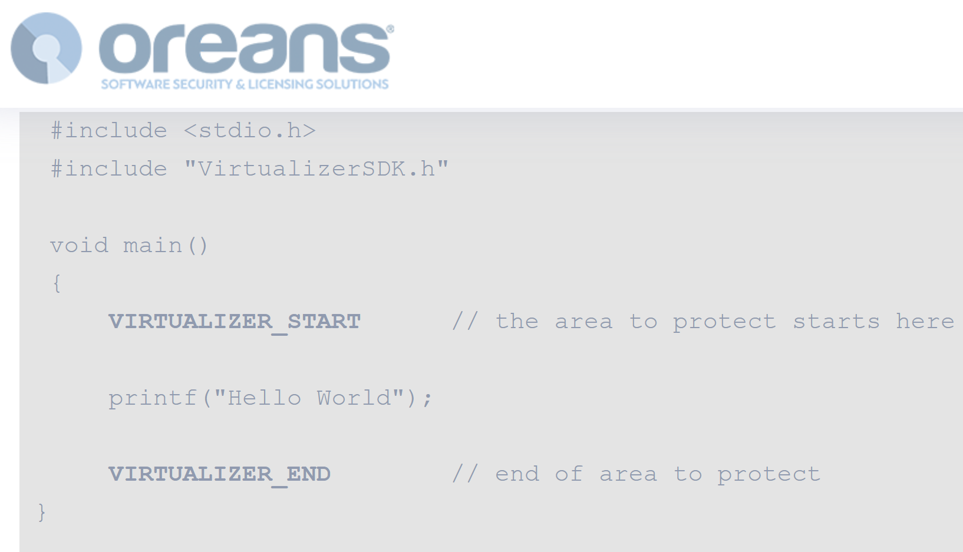
CodeVirtualizer
https://www.oreans.com/CodeVirtualizer.php
Notes:
V praxi to znamena, ze sa prechadza zo statickej na dynamicku analyzu a ked zlyha posunietie sluzobne mladsiemu kolegovi

Slide 6
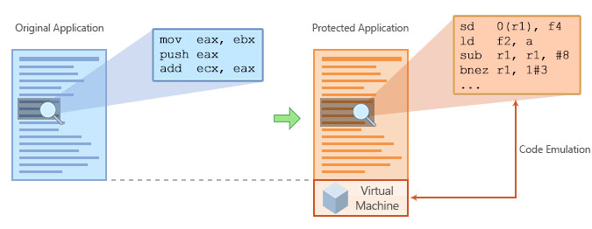
CodeVirtualizer
https://www.oreans.com/assets/images/figure_final.jpg
Notes:
Kodova sekcia na obrazku, PE ma niekolko. Strojovy kod/byte kod(nepotrebuje Xecutable flag, iba na citanie) pod lupami. Dalsi slide nas prinos, detaily virtualneho stroja

Slide 7
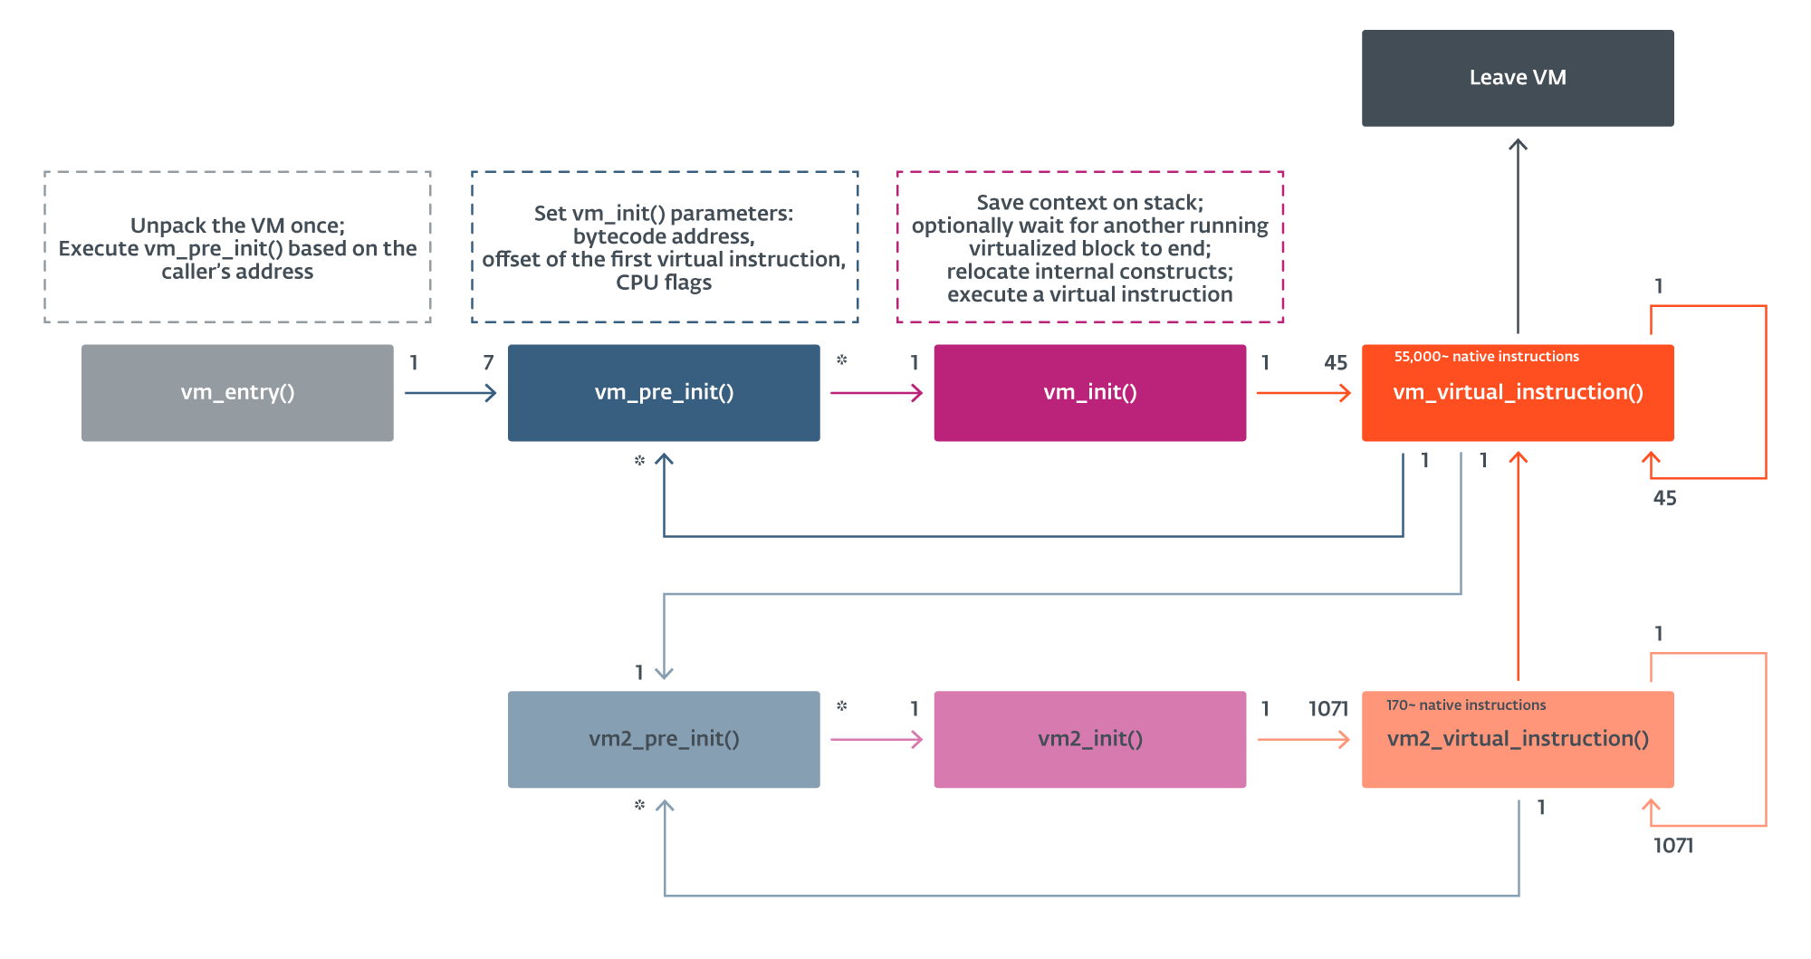
Overview of the VM’s structure
Notes:
Prva vychytavka – vnorena VM. Zdorazni hlavne pocet native instrukcii. Kazda instrukcia vytiahne opkod dalsej. Kombinuje obfuskacne techniky junk code, encoding of virtual operands, duplication of virtual opcodes, opaque predicates (neprehladne predikaty, disassembly netrivialne rozhodnutelne podmienky vzdy s rovnakym cielom), merging of virtual instructions, and a nested virtual machine

Slide 8
Attacks
Manually build a disassembler
Rolles R. Unpacking virtualization obfuscators, 3rd USENIX Workshop on Offensive Technologies, 2009
Program synthesis of handlers – slow
Blazytko T, Contag M, Aschermann C, Holz T, Syntia: Synthesizing the semantics of obfuscated code, 26th USENIX Security Symposium, pages 643-659, 2017
Path coverage and trace merging – limitations and slow
Salwan J, Bardin S, Potet ML, Symbolic deobfuscation: From virtualized code back to the original, International Conference on Detection of Intrusions and Malware, and Vulnerability Assessment, pages 372-392, 2018
Notes:
Symbolicke vykonavanie - akysi sumar efektov virtualnej instrukcie – akym sposobom je upravene kazde miesto v pamati a kazdy register

Slide 9
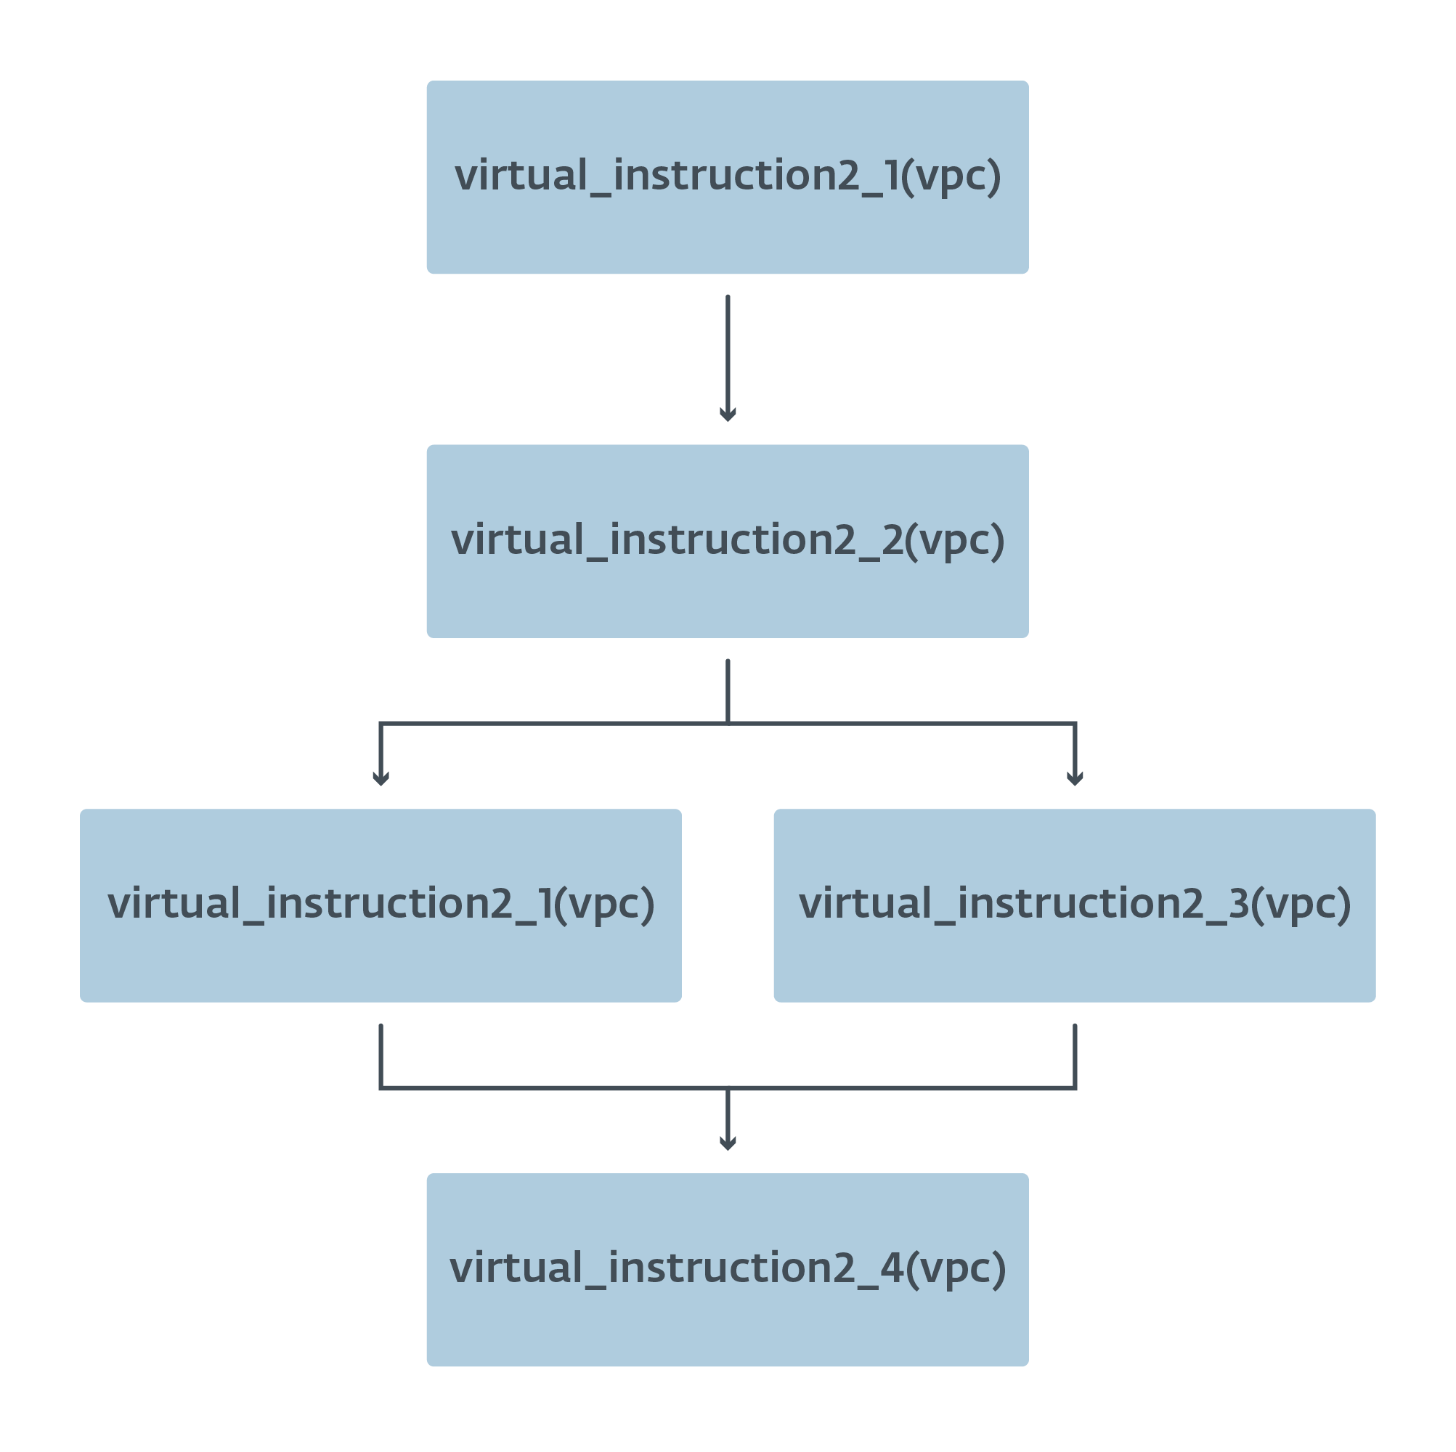
Our approach
Virtual instruction summary:
RIP = @64[@64[RBP_init + 0xA4] + 0x5A8]
@64[RBP_init + 0x28] = @64[RBP_init + 0x28] + 0x8
@64[RBP_init + 0x141] = @64[RBP_init + 0x141] + 0x8
@64[RBP_init + 0x12A] = @64[RSP_init]
Build a graph from summaries
Treat some values as concrete:
Rolling decryption registers
Memory accesses relative to the bytecode pointer
Between blocks preserve only the decryption registers

Slide 10
Virtual instruction summary
RIP = @64[@64[RBP_init + 0xA4] + 0x5A8]
@64[RBP_init + 0x28] = @64[RBP_init + 0x28] + 0x8
@64[RBP_init + 0x141] = @64[RBP_init + 0x141] + 0x8
@64[RBP_init + 0x12A] = @64[RSP_init]
RIP = @64[instruction_table + 0x5A8]
IEIP = IEIP + 0x8
IRSP = IRSP + 0x8
REG1 = @64[RSP_init]
POP REG1
Notes:
Vyrazy su ako keby atomicke, _init oznacuje pociatocnu hodnotu. Sumar jednej z jednoduhsich rieseni. Po aplikovani naseho postupu. Po jednoduchej substitucii, ktoru nerobime. Pattern matching – buduca praca

Slide 11
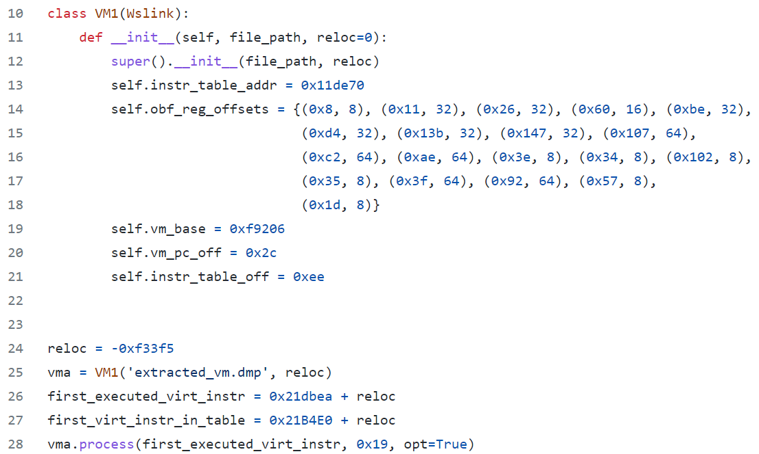
Source code init
Notes:
Na deobfuskovanie kusu bytekodu potrebujeme manualne identifikovat niekolko konstruktov. Do buducna heuristika. Python. Miasm.

Slide 12
DEOBFUSCATED
Notes:
Pozrieme sa na slucku a porovname s neobfuskovanym samplom

Slide 13
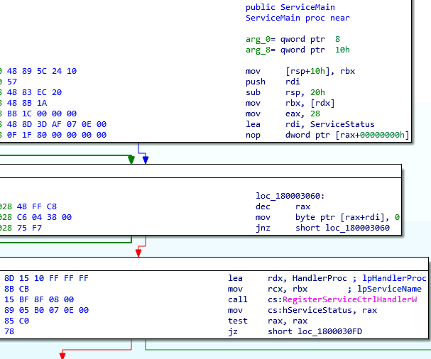
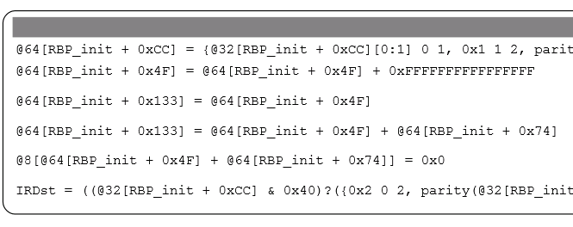
REG1 -= 1
[REG1+REG2] = 0
DEOBFUSCATED
ORIGINAL SAMPLE
Notes:
Bytekod nepredstavuje celu funkciu, mozme vylepsit spajanim vystupov. Zvysne navrhy na zlepsenie som spomenul. Ako robi call

Slide 14
Analyzing results
Bytecode block | VM1 | VM2
Size in bytes | 695 | 1,145
Total number of processed virtual instructions | 62 | 109
Total number of underlying native instructions | 3,536,427 | 17,406
Total number of resulting IR instructions (including IRDsts) | 192 | 307
Execution time in seconds | 382 | 10
Notes:
Before we look at the devirtualized bytecode, let’s see what the execution time is approximately like
Let’s look at the deobfuscated bytecode block of VM1 <CLICK>

Slide 15
Thank you
Notes:
Preco lepsie ako manualne? Da sa aplikovat na ine a preco prave tato? Da sa lahko zmenit obfuscator a pokazit to?

